Slide 1

INSTITUTE UIE
DEPARTMENT ACADEMIC UNIT-1
Bachelor of Engineering (Computer Science & Engineering)
Subject Name Introduction Electrical & Electronics Engineering
Subject Code 23ECH-101
Prepared By
Dr. Shikha
Unit-2 Chapter-2
Semiconductor Memory
Lecture No. 2.1.10
Semi Conductors Memories
DISCOVER . LEARN . EMPOWER

Slide 2

Course Objectives
S. No. | Objectives
1 | Understand Electrical & Electronics Engineering Fundamentals
2 | To prepare students to perform the analysis and design of various Electrical & digital electronic circuits.

Slide 3
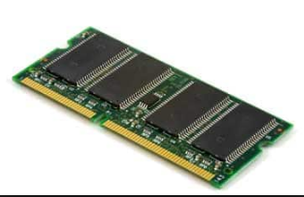
Course Outcome
CO Number | Title | Level
CO1 | To identify the different types of electrical elements and the basic op-amp circuit elements and to illustrate the various types of motors, transducers. | Remember
CO2 | To understand basic principles of transformers, transducers, op-amps, DC and AC motors and to compare the different methods for analysing electrical and magnetic circuits. | Understand
CO3 | To derive the relationships between parameters in electric and magnetic circuits and motors and to determine specifications of op-amps. | Analyze
CO4 | To solve the basic problems related to electric circuits, magnetic circuits and motors and to assess the characteristics of different configurations of op-amps. | Evaluate
CO5 | To design the different applications of transducers, motors as well as the op-amps like adders, subtractor and comparators. | Create
Semi Conductor Memories

Slide 4
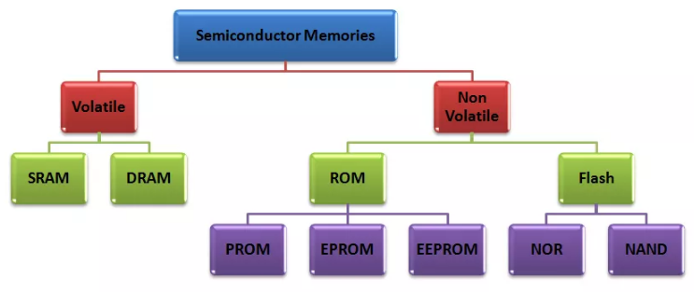
Semi Conductor Memories
Classification
Applications

Slide 5
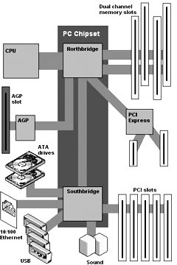
Memory
semiconductor-based integrated circuit
•
All actual computing starts with the the CPU
(Central Processing Unit).
•
The chipset supports the CPU and contains several controllers that control how information travels between the CPU and other components in the PC.
•
The memory controller is part of the chipset and establishes the information flow between memory and the CPU.
•
A bus is a data path that consists of parallel wires and connects the CPU, memory and other devices. The bus architecture determines how much and how fast data can move around the motherboard.
•
The memory bus goes from the memory controller to the computer's memory sockets. Newer systems have a frontside bus (FSB) from the CPU to main memory and a backside bus (BSB) from the memory controller to L2 cache.

Slide 6
Role of Memory during Boot-up
•
You turn the computer on.
•
The computer loads data from read-only memory (ROM) and performs a power- on self-test (POST) to make sure all the major components are functioning properly. As part of this test, the memory controller checks all of the memory addresses with a quick read/write operation to ensure that there are no errors in the memory chips. Read/write means that data is written to a bit and then read from that bit.
•
The computer loads the basic input/output system (BIOS) from ROM. The BIOS provides the most basic information about storage devices, boot sequence, security, Plug and Play (auto device recognition) capability and a few other items.
The computer loads the operating system (OS) from the hard drive into the system's RAM. Generally, the critical parts of the operating system are maintained in RAM as long as the computer is on. This allows the CPU to have immediate access to the operating system, which enhances the performance and functionality of the overall system.

Slide 7
Role of Memory during Boot-up
•
When you open an application, it is loaded into RAM. To conserve RAM usage, many applications load only the essential parts of the program initially and then load other pieces as needed.
•
After an application is loaded, any files that are opened for use in that application are loaded into RAM.
•
When you save a file and close the application, the file is written to the specified storage device, and then it and the application are purged from RAM.

Slide 8
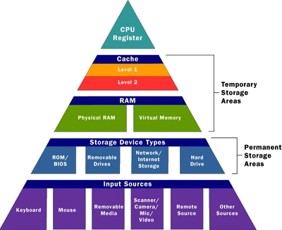
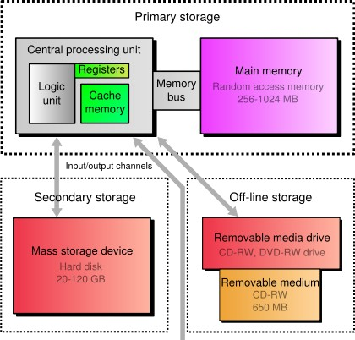
Memory
semiconductor-based integrated circuit

Slide 9
Memory Structure
Memory
Non Volatile
Volatile
ROM
RAM
PROM
Static
EPROM
EEPROM
Dynamic
FLASH
NOR
NAND
Hard-Disk, CD, DVD, Floppy Disk, Magnetic Tape, USB Flash memory, SD Card

Slide 10
Computer memory is the storage space in computer where data is to be processed and instructions required for processing are stored. Computer has 64k words, then this memory unit has 64 * 1024 = 65536 memory location. The address of these locations varies from 0 to 65535. S/C Memories
Semi Conductor Memories
RAM
ROM
Flash
UV EPROM
SRAM
DRAM
MASK
EEPROM
PROM
EPROM

Slide 11
Volatile memory
requires power to maintain the stored information
•
DRAM, e.g. DDR SDRAM (Dynamic)
•
SRAM (Cache Memory) (Static)

Slide 12
RAM
Random Access Memory
It takes the form of integrated circuits that allow the stored data to be accessed in any order, i.e. at random. Regardless of the memory location that was last accessed.
RAM generally store a bit of data in either the state of a flip-flop, as in SRAM (static RAM), or as a charge in a capacitor (or transistor gate), as in DRAM (dynamic RAM), EPROM, EEPROM and Flash.
Some types have circuitry to detect and/or correct random faults called memory errors in the stored data, using parity bits or error correction codes. RAM of the read-only type, ROM, instead uses a metal mask to permanently enable/disable selected transistors, instead of storing a charge in them.

Slide 13
RAM (Random Access Memory)
RAM is for temporary data storage. It is read/write memory and can store data only when power is applied, hence it is volatile.
Two categories are static RAM (SRAM) and dynamic RAM (DRAM).
SRAM or Static Random Access Memory is a form of semiconductor memory widely used in electronics, microprocessor and general computing applications. This form of semiconductor memory gains its name from the fact that data is held in there in a static fashion, and does not need to be dynamically updated as in the case of DRAM memory. While the data in the SRAM memory does not need to be refreshed dynamically, it is still volatile, meaning that when the power is removed from the memory device, the data is not held, and will disappear. SRAM uses semiconductor latch memory cells. The cells are organized into an array of rows and columns. SRAM is faster than DRAM but is more complex, takes up more space, and is more expensive.
It stores each bit of data on a small capacitor within the memory cell. The capacitor can be either charged or discharged and this provides the two states, "1" or "0" for the cell. Since the charge within the capacitor leaks, it is necessary to refresh each memory cell periodically. This refresh requirement gives rise to the term dynamic - static memories do not have a need to be refreshed. The advantage of a DRAM is the simplicity of the cell - it only requires a single transistor compared to around six in a typical static RAM, SRAM memory cell. In view of its simplicity, the costs of DRAM are much lower than those for SRAM, and they are able to provide much higher levels of memory density. However the DRAM has disadvantages as well, and as a result, most computers use both DRAM technology and SRAM, but in different areas.In view of the fact that power is required for the DRAM to maintain its data, it is what is termed a volatile memory. Memory technologies such as Flash are non-volatile and retain data even when the power is removed

Slide 14
SRAM
Static Random Access Memory
Static Random Access Memory uses multiple transistors, typically four to six, for each memory cell but doesn't have a capacitor in each cell. It is used primarily for cache.
Static indicates that it, unlike dynamic RAM (DRAM), does not need to be periodically refreshed, as SRAM uses bi-stable latching circuitry to store each bit.
An SRAM cell has three different states it can be in: standby where the circuit is idle, reading when the data has been requested and writing when updating the contents.
Cache memory is a relatively small amount (normally less than 1 MB) of high speed memory and resides very close to the CPU. It is designed to supply the CPU with the most frequently requested data. It takes a fraction of the time, compared to normal memory, to access cache memory.

Slide 15
DRAM
Dynamic Random Access Memory
DRAM:
Dynamic random access memory has memory cells with a paired transistor and capacitor requiring constant refreshing.
TYPES OF DRAM SDRAM:
Synchronous dynamic random access memory takes advantage of the burst mode concept to greatly improve performance. It does this by staying on the row containing the requested bit and moving rapidly through the columns, reading each bit as it goes. The idea is that most of the time the data needed by the CPU will be in sequence. SDRAM is about five percent faster than EDO RAM and is the most common form in desktops today. Maximum transfer rate to L2 cache is approximately 528 Mbps.
DDR SDRAM:
Double data rate synchronous dynamic RAM is just like SDRAM except that is has higher bandwidth, meaning greater speed. Maximum transfer rate to L2 cache is approximately 1,064 MBps (for DDR SDRAM 133 MHZ).

Slide 16
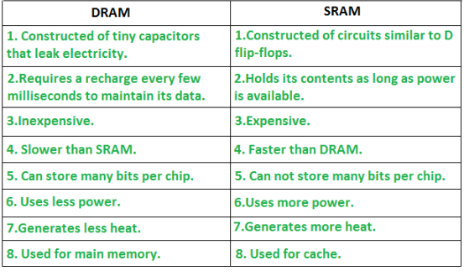
Difference

Slide 17
Non-volatile
Retains the stored information even when not powered
•
Electrically Addressed
ROM
PROM
EAROM
EPROM
EEPROM
Flash memory (NOR and NAND)
•
•
Mechanically Addressed System
•
•
•
•
Tape Hard disk
Optical disk (CD, DVD) Magnetic Disk (Floppy Disk)

Slide 18
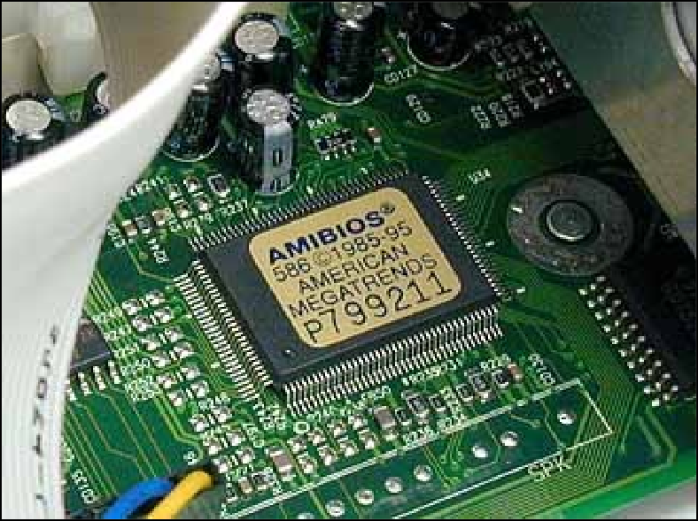
ROM
Read-only memory
•
Stored-program computer requires some form of non-volatile storage to store the initial program that runs when the computer is powered on or otherwise begins execution (a process known as bootstrapping, often abbreviated to "booting" or "booting up")
•
Read-only memory (ROM), also known as firmware, is an integrated circuit programmed with specific data when it is manufactured. ROM chips are used not only in computers, but in most other electronic items as well.

Slide 19
ROM (Read Only Memory)
Stores crucial information essential to operate the system, like the program essential to boot the computer.
It is not volatile.
Always retains its data.
Used in embedded systems or where the programming needs no change.
Used in calculators and peripheral devices.
ROM is further classified into 4 types- ROM, PROM, EPROM, and EEPROM.

Slide 20
PROM (Programmable read-only memory) – It can be programmed by user. Once programmed, the data and instructions in it cannot be changed.
EPROM (Erasable Programmable read only memory) – It can be reprogrammed. To erase data from it, expose it to ultra violet light. To reprogram it, erase all the previous data.
EEPROM (Electrically erasable programmable read only memory) – The data can be erased by applying electric field, no need of ultra violet light. We can erase only portions of the chip.

Slide 21
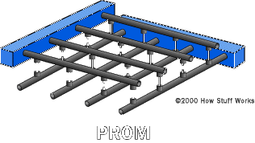
PROM
Programmable Read Only Memory
•
Programmable read-only memory (PROM) or field programmable read-only memory (FPROM) is a form of digital memory where the setting of each bit is locked by a fuse or antifuse. Such PROMs are used to store programs permanently. The key difference from a strict ROM is that the programming is applied after the device is constructed.
•
Creating ROM chips totally from scratch is time-consuming and very expensive in small quantities. For this reason, mainly, developers created a type of ROM known as programmable read-only memory (PROM). Blank PROM chips can be bought inexpensively and coded by anyone with a special tool called a programmer.
•
Advantages
•
•
•
•
Reliability
Stores data permanently Moderate price
Built using integrated circuits, rather than discrete components.
Fast: speed is between 35ns and 60ns.
•

Slide 22
EPROM
Erasable Programmable Read Only Memory
•
It is an array of floating-gate transistors individually programmed by an electronic device that supplies higher voltages than those normally used in electronic circuits. Once programmed, an EPROM can be erased only by exposing it to strong ultraviolet light.
Working with ROMs and PROMs can be a wasteful business. Even though they are inexpensive per chip, the cost can add up over time. Erasable programmable read-only memory (EPROM) addresses this issue. EPROM chips can be rewritten many times. Erasing an EPROM requires a special tool that emits a certain frequency of ultraviolet (UV) light. EPROM's are configured using an EPROM programmer that provides voltage at specified levels depending on the type of EPROM used.
•
EPROM's are easily recognizable by the transparent fused quartz window in the top of the package, through which the silicon chip can be seen, and which permits UV light during erasing.

Slide 23
EEPROM
Electrically Erasable Programmable Read Only Memory
•
Though EPROMs are a big step up from PROMs in terms of reusability, they still require dedicated equipment and a labor-intensive process to remove and reinstall them each time a change is necessary. Also, changes cannot be made incrementally to an EPROM; the whole chip must be erased. Electrically erasable programmable read-only memory (EEPROM) chips remove the biggest drawbacks of EPROMs. In EEPROMs:
The chip does not have to removed to be rewritten.
The entire chip does not have to be completely erased to change a specific portion of it.
Changing the contents does not require additional dedicated equipment.
here are different types of electrical interfaces to EEPROM devices. Main categories of these interface types are :
•
•
•
•
•
•
How the device is operated depends on the electrical interface.
Serial bus Parallel bus
•

Slide 24
Comparison
EEPROM
Electrically byte-erasable
Lower reliability
Higher cost
Lower density
EPROM EEPROM
FLASH
Full-Feature Memory Solution
Updateable
Non-volatile
FLASH
ROM
DRAM
High Density
DRAM
High density
Low cost
High speed
High power
ROM
High density
Reliable
Low cost
Suitable for stable code production
Flash Memory
Low-cost, high density
High speed architecture
Lower power
High reliability

Slide 25
APPLICATIONS
Computers
Calculators
ATM
Mobile Phone
Integrated Circuits and so on......

Slide 26
REFERENCES
Floyd & Jain, Digital Fundamentals, Pearson.
Mano,Morris, Digital Design, Prentice Hall of India.
Fletcher, An Engg. Approach to digital design, Prentice Hall of India.
http://www.geeksforgeeks.org/digital-electronics-logic-design-tutorials/
http://www.ni.com/example/14493/en/
http://195.134.76.37/applets/AppletGates/Appl_Gates2.html
https://www.allaboutcircuits.com/textbook/digital/
https://www.tutorialspoint.com/digital_electronics/index.asp
https://www.tutorialspoint.com/computer_logical_organization/complement_arithmetic.htm

Slide 27
THANK YOU

